Slide 1
Chiba Campaign 2020
Daily Report (11/30~) :
Tropospheric NO₂,
Planetary Boundary Layer Height
2020/12/07
Irie Laboratory Saito Hikaru(齊藤 輝)

Slide 2
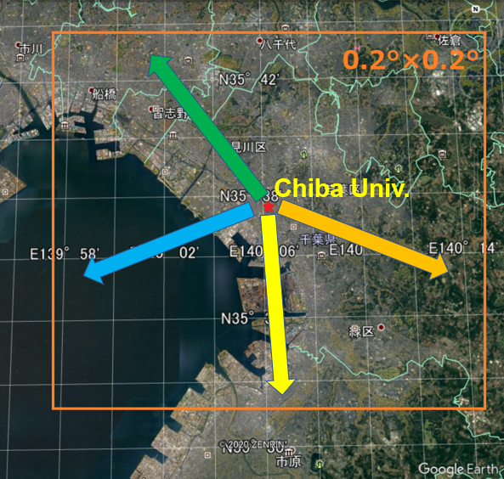
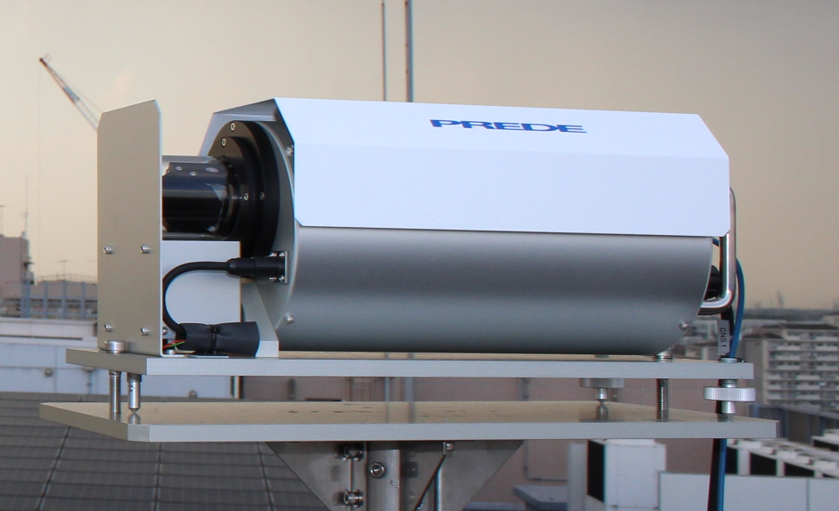
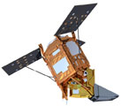
Tropospheric NO₂ column density data
4AZ-MAXDOAS (Ground-based)
Plot…
・All measurements
・Daily average
TROPOMI (TROPOspheric Monitoring Instrument) (Satellite-based)
Plot…
・Daily 0.2°×0.2° average, cloud<0.2 data
・Standard Deviation in pixels of 1-day data
1995
2002
2004
20km

Slide 3
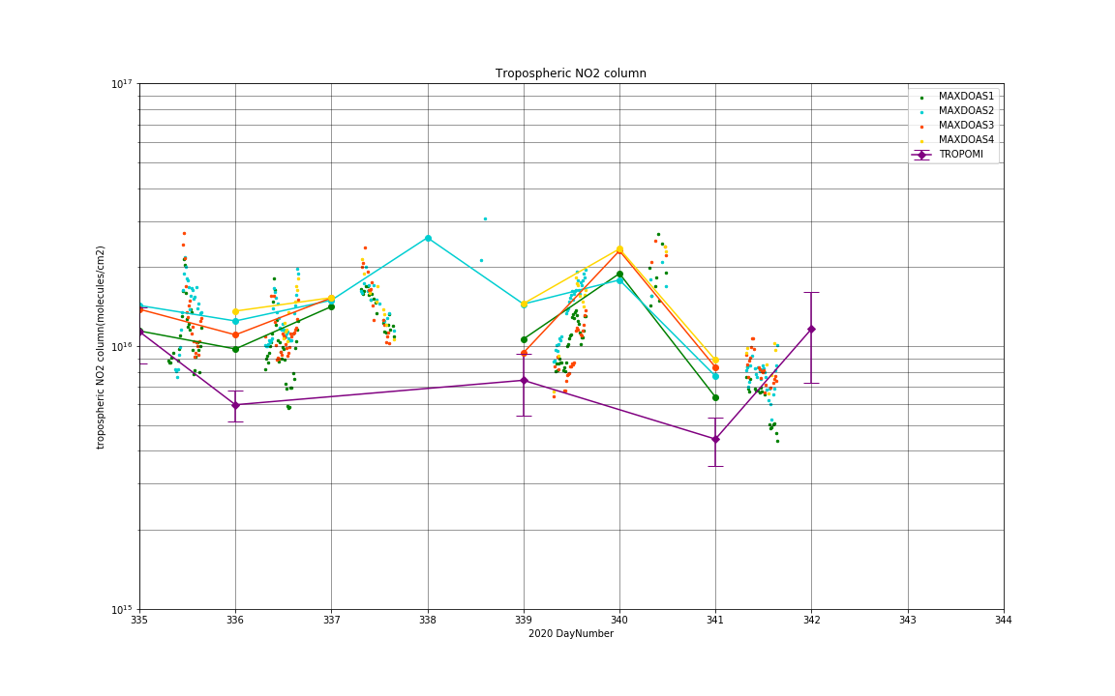
1995
2002
2004
11/30 12/5
20km
TROPOMI pixels | 11 | 15 | 0 | 0 | 8 | 0 | 10 | 20

Slide 4
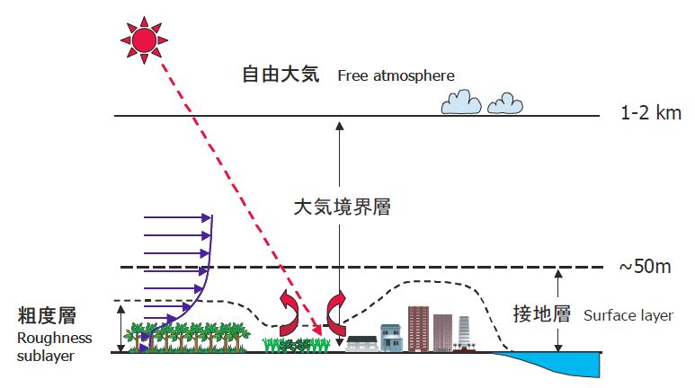
Mixing (Planetary Boundary) Layer Height
(大気境界層の厚さ)
・Varies depending on daytime/seasons
・Possibly affect satellite observation
・Data: NIES lidar
（環境研ライダー） https://www-lidar.nies.go.jp/AD-Net/
http://wwwoa.ees.hokudai.ac.jp/research/pbl.html

Slide 5
